Slide 1
Maths Quiz

Slide 2
Question 1
If 5 dogs each buried 4 bones, how many bones were buried?

Slide 3
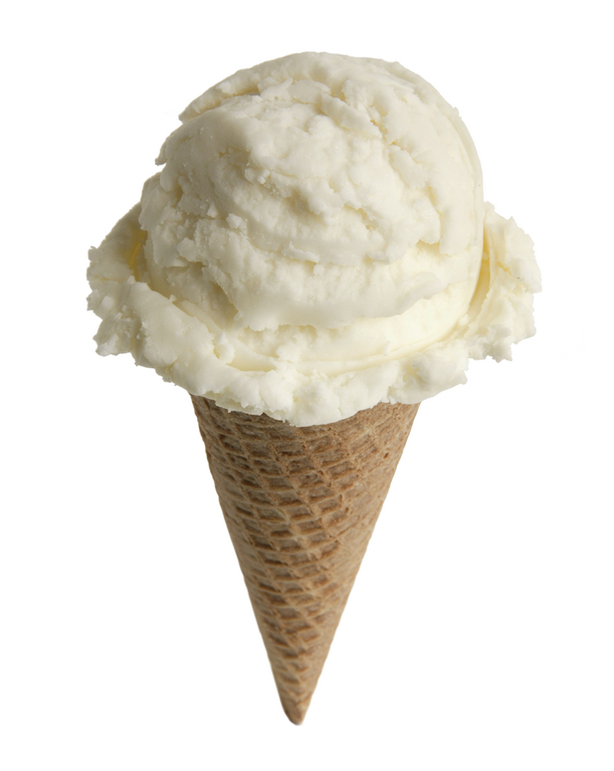
Question 2
If 9 boys each ate 2 ice creams, how many ice creams were eaten?

Slide 4
Question 3
If you saw 3 scary movies, each of which had 6 monsters, how many monsters did you see altogether?

Slide 5
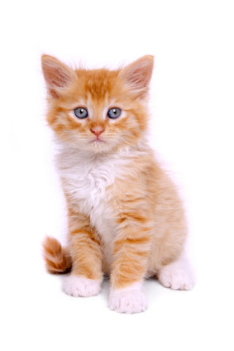
Question 4
If you gave 5 kittens 8 cuddles each, how many cat cuddles did you give?

Slide 6
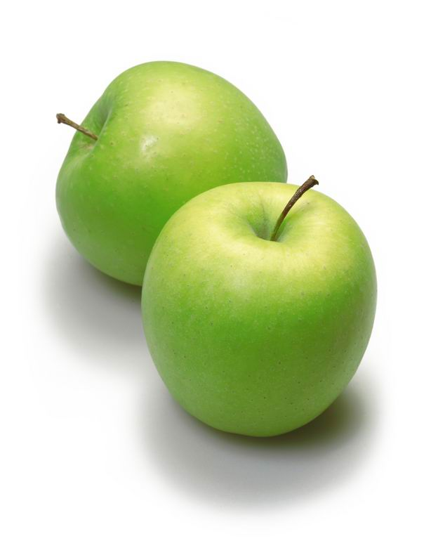
Question 5
If 6 trees each had 7 apples, how many apples were there?

Slide 7
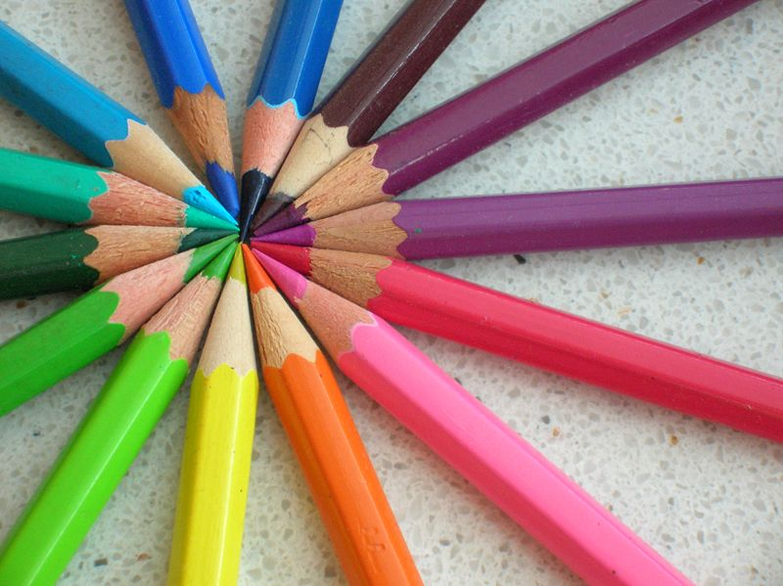
Question 6
If 7 sisters each had 9 pencils, how many pencils did the sisters have in total?

Slide 8
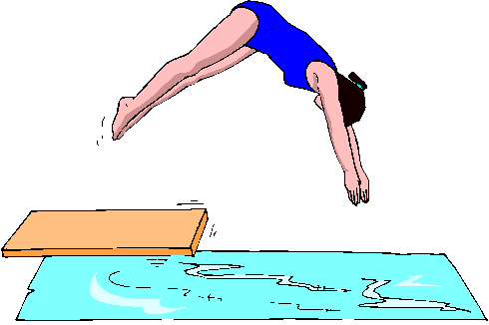
Question 7
If 11 girls each dove into the pool 4 times, how many dives were performed?

Slide 9
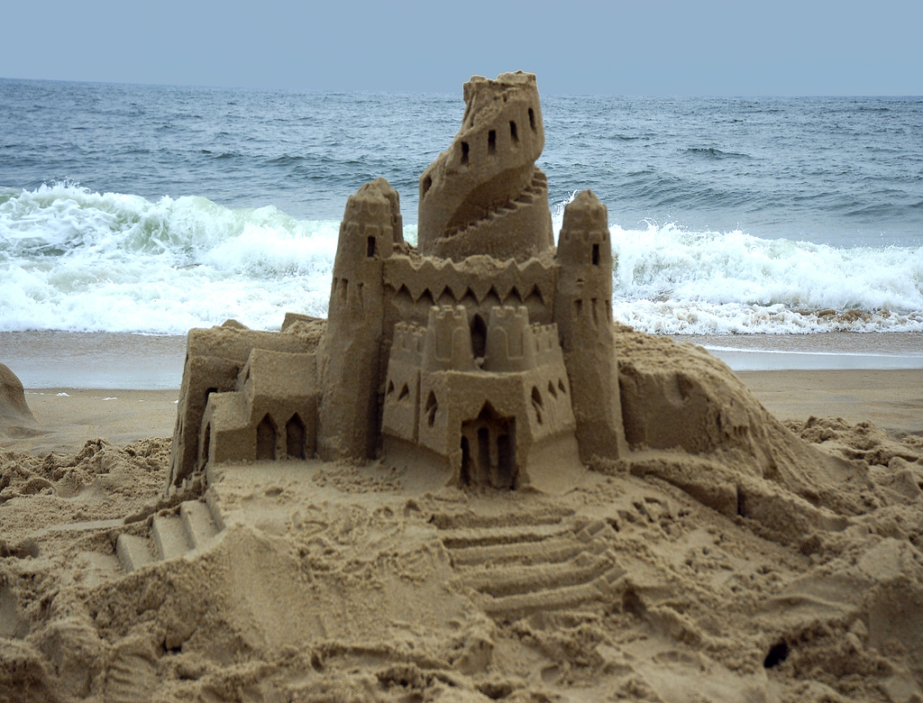
Question 8
If 9 children each built 8 sandcastles, how many sandcastles were built?

Slide 10
Question 9
If you took 8 math's quizzes, each of which had 12 questions, how many questions did you answer?

Slide 11
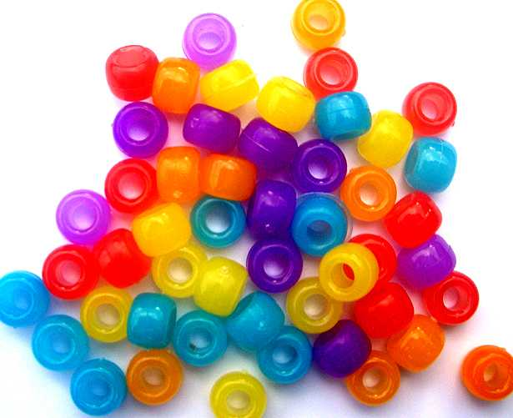
Question 10
If you strung 12 necklaces, each of which had 11 beads, how many beads did you use?

Slide 12
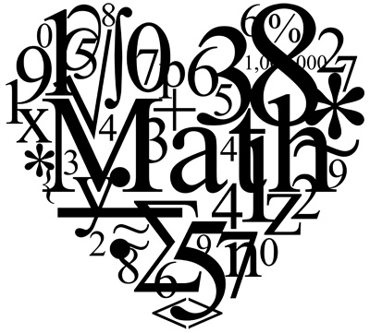
How did you do?

