Slide 1
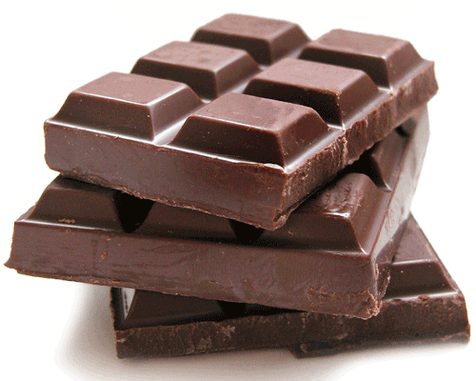
Name the Sweets Quiz

Slide 2
Question 1
Name the sweets

Slide 3
Question 2
Name the sweets

Slide 4
Question 3
Name the sweets

Slide 5
Question 4
Name the sweets

Slide 6
Question 5
Name the sweets

Slide 7
Question 6
Name the sweets

Slide 8
Question 7
Name the sweets

Slide 9
Question 8
Name the sweets

Slide 10
Question 9
Name the sweets

Slide 11
Question 10
Name the sweets

Slide 12
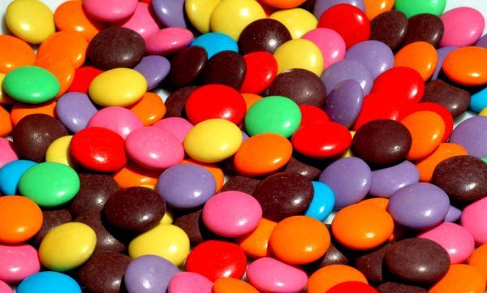
Get ready for the answers!

Slide 13
Question 1
Name the sweets
Crunchie

Slide 14
Question 2
Name the sweets
Wispa

Slide 15
Question 3
Name the sweets
Dairy Milk

Slide 16
Question 4
Name the sweets
Refreshers

Slide 17
Question 5
Name the sweets
Flake

Slide 18
Question 6
Name the sweets
Snickers

Slide 19
Question 7
Name the sweets
Kit Kat

Slide 20
Question 8
Name the sweets
Ripple

Slide 21
Question 9
Name the sweets
Twisted

Slide 22
Question 10
Name the sweets
Tic Tacs

Slide 23
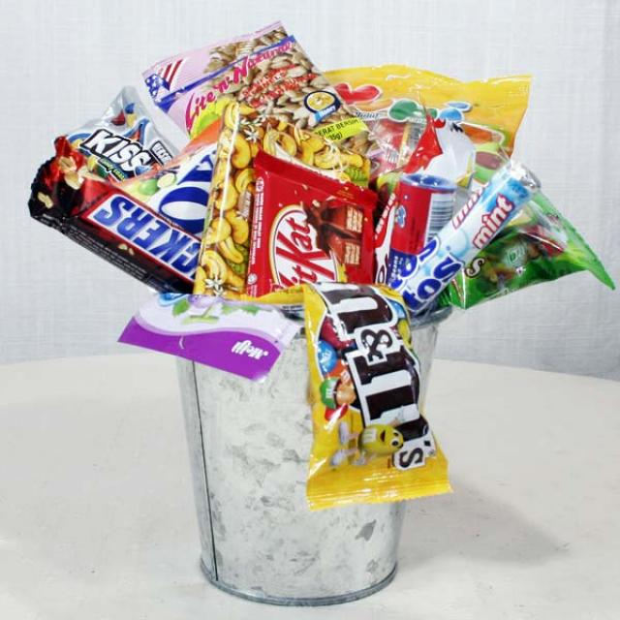
How did you do?

