Slide 1
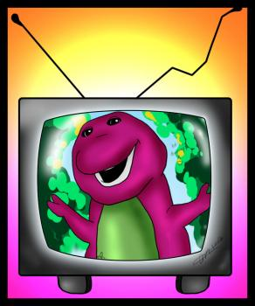
TV Trivia Quiz

Slide 2
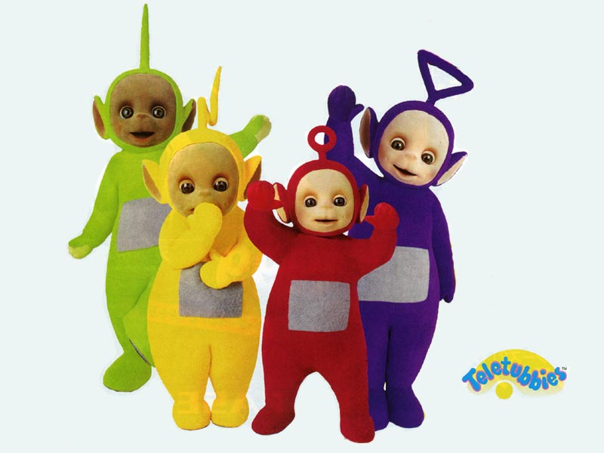
Question 1
What’s the red one called?

Slide 3
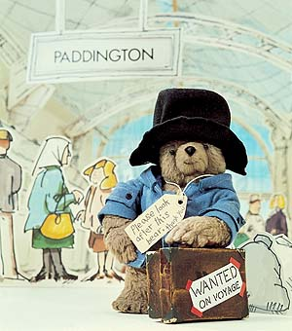
Question 2
What are Paddington Bears favourite sandwiches?

Slide 4
Question 3
Who is this?

Slide 5
Question 4
What object does Iggle Piggle usually carry around with him?

Slide 6
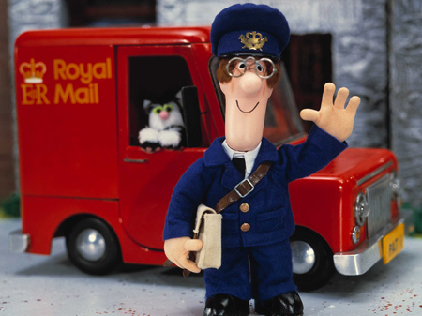
Question 5
What is Post man Pat’s cat called?

Slide 7
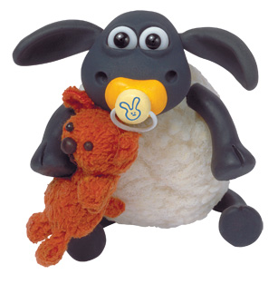
Question 6
Name Shaun’s tiny friend.

Slide 8
Question 7
In what year did Blue Peter first begin transmission?
1958
1968
1978

Slide 9
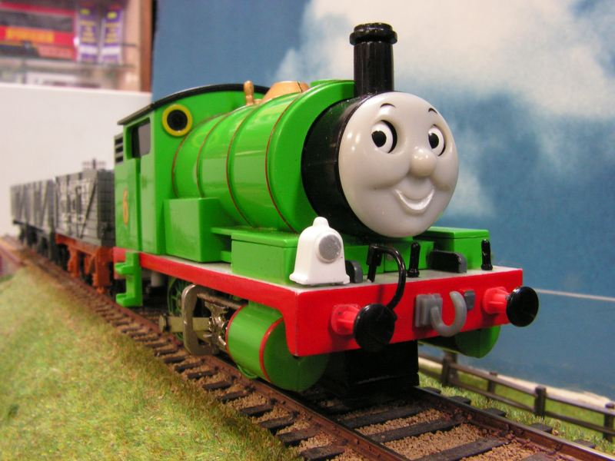
Question 8
What number does Percy the Small Engine have on his bunker?

Slide 10
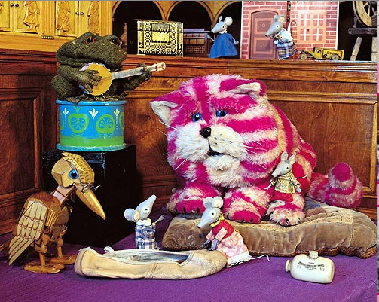
Get ready for the answers!

Slide 11
Question 1
Po
What’s the red one called?

Slide 12
Question 2
What are his favourite sandwiches?
Marmalade

Slide 13
Question 3
Who is this?
Mr Happy

Slide 14
Question 4
What object does Iggle Piggle usually carry around with him?
A Red Blanket
1 point for the object
1 point for the colour

Slide 15
Question 5
What is Pat’s cat called?
Jess

Slide 16
Question 6
Name Shaun’s tiny friend.
Timmy

Slide 17
Question 9
In what year did Blue Peter first begin transmission?
1958
1968
1978

Slide 18
Question 10
What number does Percy the Small Engine have on his bunker?
6

Slide 19
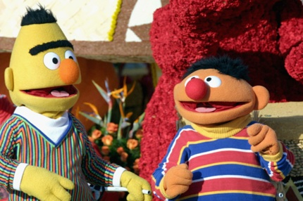
How did you do?

