Slide 1
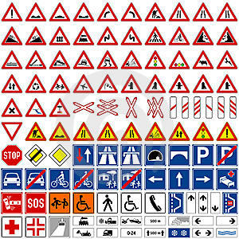
Traffic Sign Quiz

Slide 2
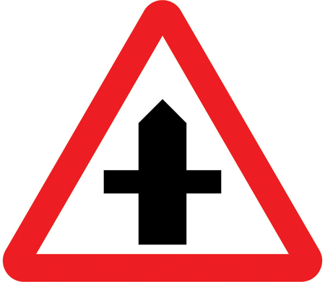
Question 1
What does this sign mean?

Slide 3
Question 2
What does this sign mean?

Slide 4
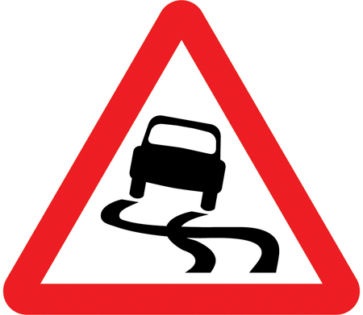
Question 3
What does this sign mean?

Slide 5
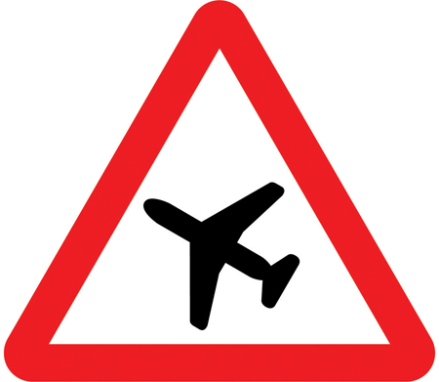
Question 4
What does this sign mean?

Slide 6
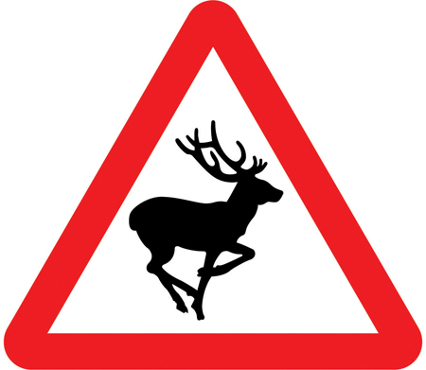
Question 5
What does this sign mean?

Slide 7
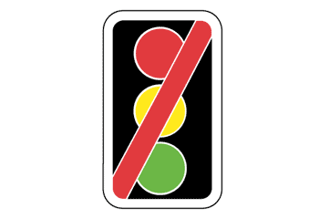
Question 6
What does this sign mean?

Slide 8
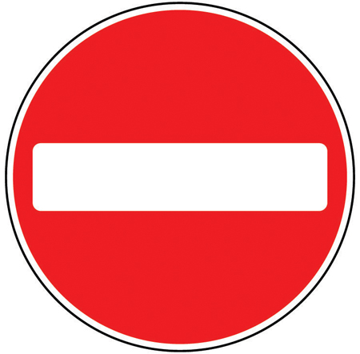
Question 7
What does this sign mean?

Slide 9
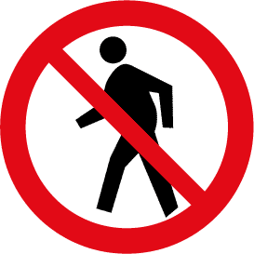
Question 8
What does this sign mean?

Slide 10
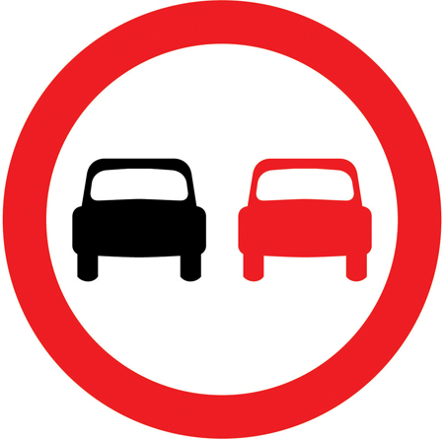
Question 9
What does this sign mean?

Slide 11
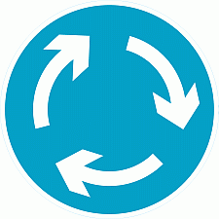
Question 10
What does this sign mean?

Slide 12
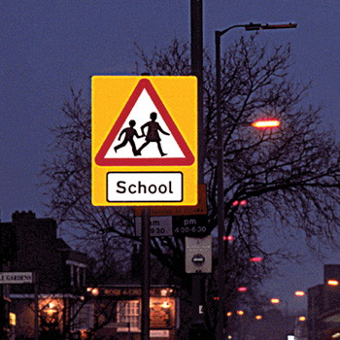
Get ready for the answers!

Slide 13
Question 1
What does this sign mean?
Crossroads

Slide 14
Question 2
What does this sign mean?
Roundabout

Slide 15
Question 3
What does this sign mean?
Slippery Road

Slide 16
Question 4
What does this sign mean?
Low Flying Aircraft

Slide 17
Question 5
What does this sign mean?
Wild Animals

Slide 18
Question 6
What does this sign mean?
Traffic Signals not in use

Slide 19
Question 7
What does this sign mean?
No Entry

Slide 20
Question 8
What does this sign mean?
No Pedestrians

Slide 21
Question 9
What does this sign mean?
No Overtaking

Slide 22
Question 10
What does this sign mean?
Mini roundabout

Slide 23
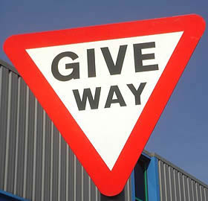
How did you do?

